Slide 1



School of Computer Science and Engineering
Department of Computer Science and Engineering
Agentic-RAG and Reinforcement Learning :
A Comparative Survey
Submitted By:
HARSHIT MANDAD
2427030400
Supervised By:
Dr. LAV UPADHYAY
________________
________________

Slide 2

Introduction
______________________________________________________________
  Large Language Models (LLMs) often produce hallucinated responses.
  Retrieval-Augmented Generation (RAG) improves factual grounding.
  Agentic RAG extends RAG using planning and multi-step reasoning.
  However, many systems rely on predefined orchestration strategies.
  This motivates a systematic comparative evaluation.

Slide 3


Background : Agentic-RAG
___________________________________________________________________
Key Components
  Retriever
  Knowledge Base (Vector Store)
  Generator (LLM)
Key Goals
  High Accuracy
  Strong Performance
  Reduced Hallucination
___________________________
___________________________

Slide 4

Literature Review
_____________________________________
Surveyed Methodologies
  Traditional Agentic RAG
  Goal-Oriented Agentic RAG
  Graph-Based RAG
  Hierarchical RAG
  Capability-Centric RAG
  Adaptive & Corrective RAG
  Domain-Specific RAG
  Unified Domain Agent Stack
Benchmarks Referenced
  HotpotQA
  Natural Questions
  MS MARCO
  Domain-Specific Industrial Knowledge Bases
  Enterprise Knowledge Bases
__________________________________
______________________________

Slide 5


Problem Statement
___________________________________________
Existing Agentic RAG frameworks rely on predefined or rule-based control strategies limiting their adaptability, scalability, and dynamic optimization in multi / complex retrieval task
----- There is a need of a framework that adapts or learns based on -----query input / performance

Slide 6

Proposed Methodology
________________________________________________
To perform a Comparative Analysis of existing Agentic-RAG Methodologies.
Identify the key limitations and challenges faced by each methodology.
Propose a framework on how to counter some of these limitations through a research / survey paper.
CORE GOAL : -
Write a Survey / Research Paper based on all findings
________________

Slide 7


TIMELINE
_____________________________
[1]
[2]
[3]
[4]
FINAL ACT
Review Survey / Research Papers
Perform a Comparative Analysis
Identiify Key Limitations / Challenges
Propose a framework to solve a challenge
Survey Paper

Slide 8

OBJECTIVES
_____________________________
Reduced reliance on predefined rules
Drafted survey paper
Proposed conceptual solution
Foundation for future experimental validation
Defined research gap

Slide 9
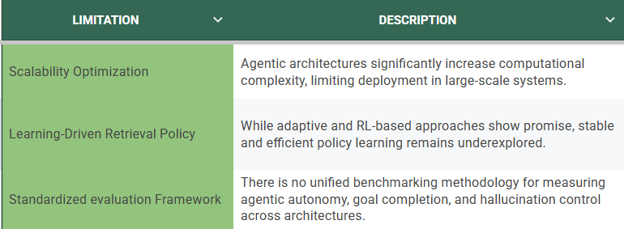
Result
_____________________________

Slide 10
References
_____________________________
[1] Agentic AI: Autonomous Intelligence for Complex Goals – A
Comprehensive Survey, 2025.
[2] Adaptive Agentic Retrieval-Augmented Generation, SSRN Working
Paper No. 5188363, 2025.
[3] Goal-Oriented Agentic Retrieval-Augmented Generation
Frameworks, 2025.
[4] Capability-Centric Agentic RAG Architectures, 2025.
[5] Domain-Specific Agentic RAG Systems and Unified Domain Agent
Stack, 2025.
[6] Multi-Agent Retrieval-Augmented Generation Systems, 2024.
[7] Future Internet, vol. 17, no. 4, 2025 – Agentic Retrieval-Augmented
Generation Study.

Slide 11

Thank
You

